Slide 1
COVID–19 : Trends and Correlations
Midterm Project
Adbi, Habel
Obeahon, Boma
Suen, Ellis

Slide 2





PROJECT STEPS
Planning
DATA COLLECTION
CLEANING
+ EDA
Statistical Modeling
Visualization

Slide 3
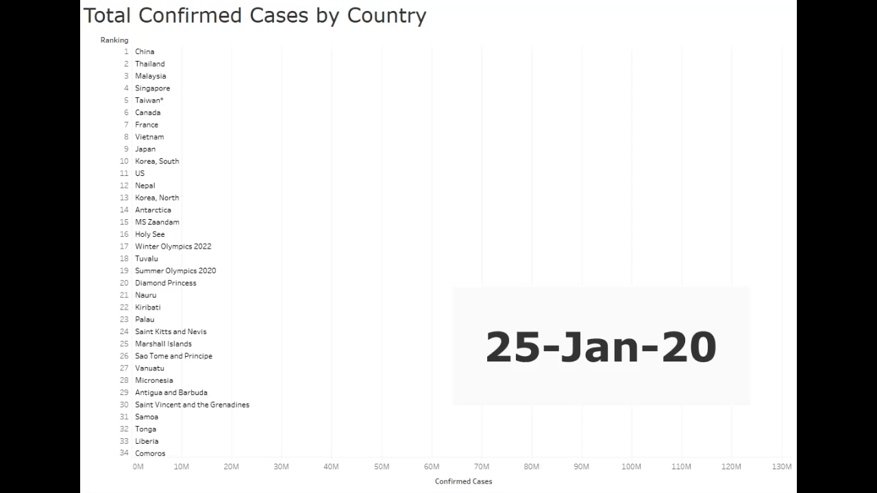
TOTAL CONFIRMED CASES

Slide 4
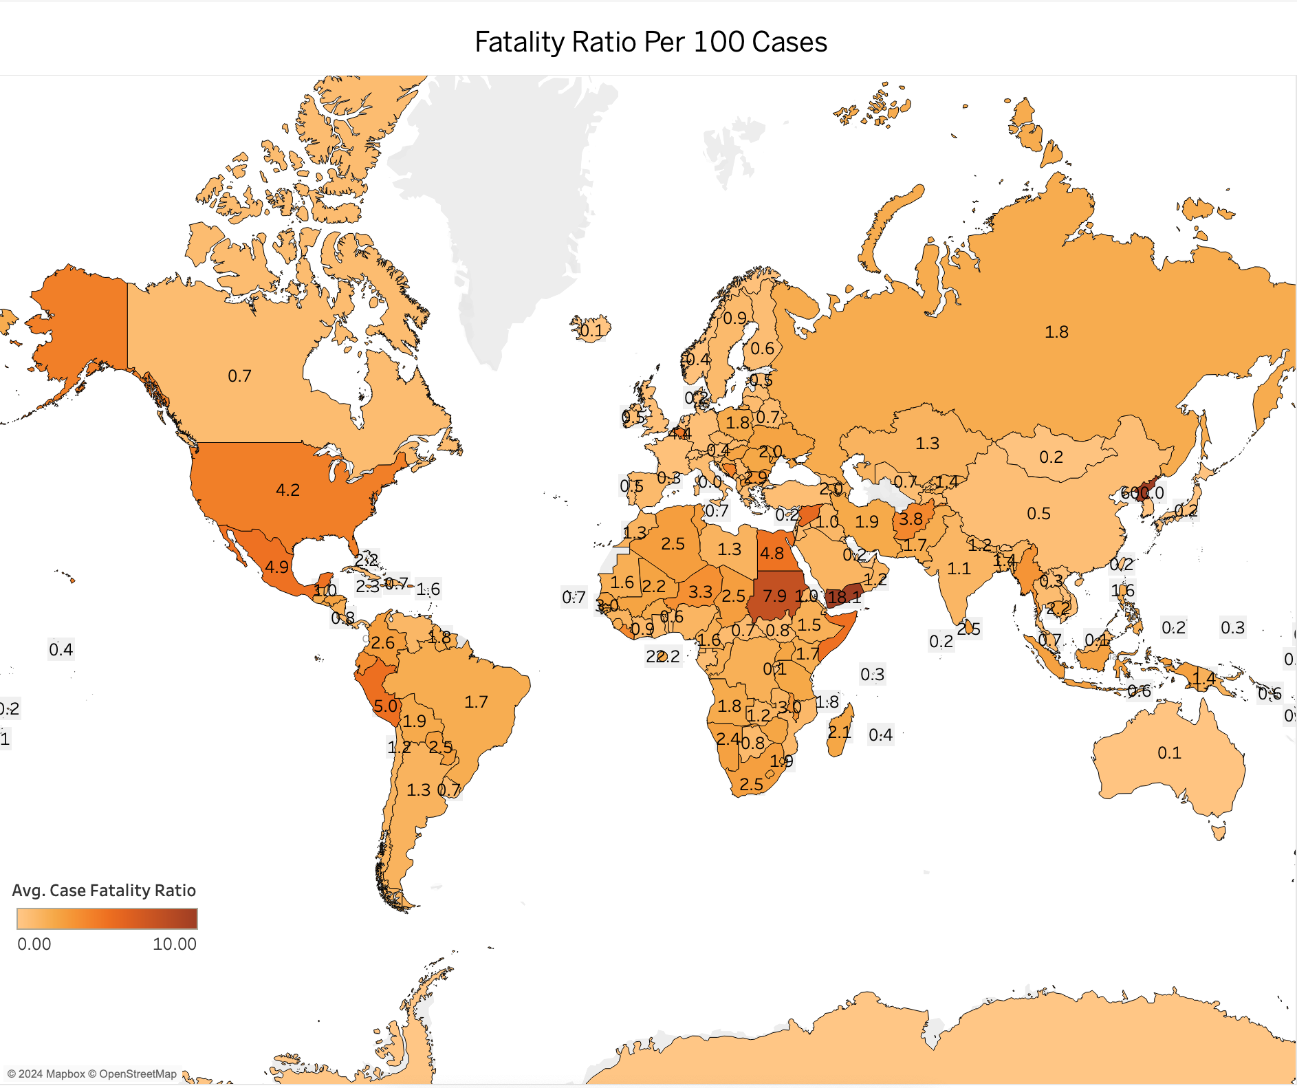
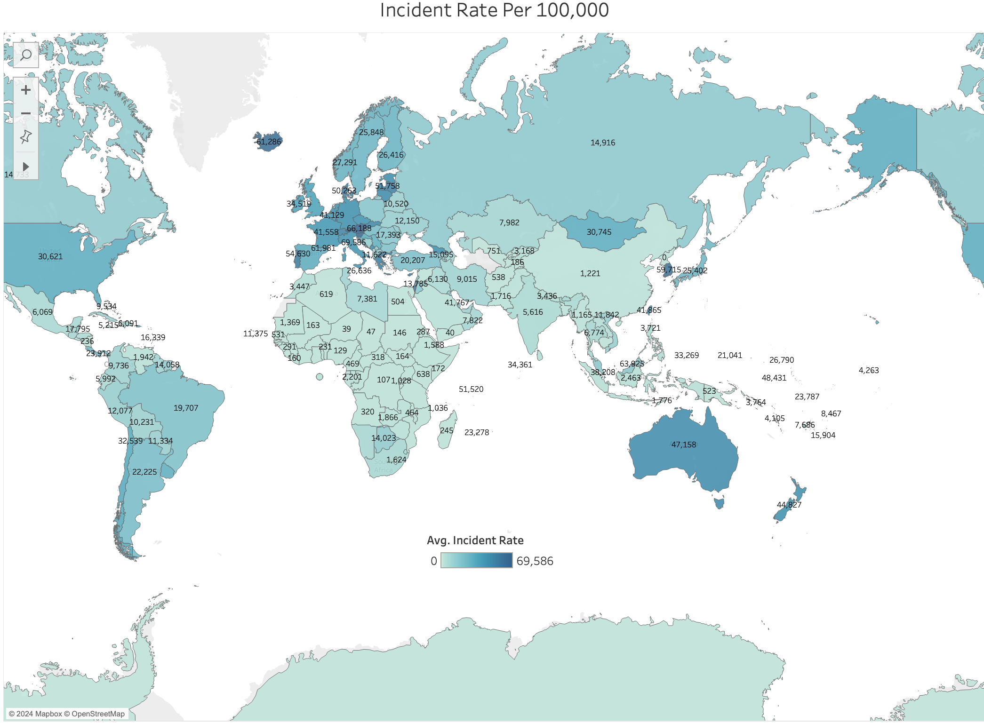
INCIDENT FACLITY VS INCENDENT RATE
Notes:
- Fatality Ratio : for every hundred cases is x amounts of deaths
- Incident Rate: for every 100,000 how many cases happen
- for the majority there is a link between the both of them,
- but there are other outlier that play a major role in fatality ratio
- for example, a country can be a common ground for contracting the case but have decent medicine and hospitals along with covid shots available
- but not necessarily practice lockdown measures and vise versa

Slide 5
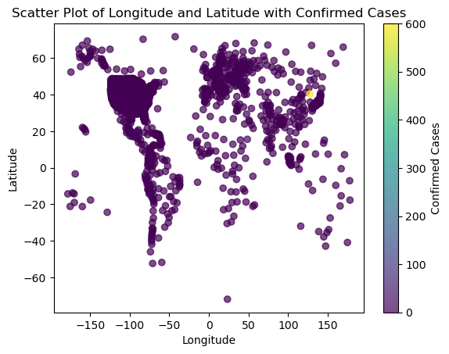
Latitude/Longitude VS
Confirmed Outcomes
Notes:
- Despite common assumptions, our data shows no clear correlation between latitude, longitude, and confirmed cases.
- Regression analyses affirm the complexity; R-squared values for deaths (0.05) and confirmed cases (0.002) highlight the challenges in predicting the virus's spread based on geographical coordinates
- Confirmed cases vary widely, indicating the virus doesn't strictly adhere to geographical lines.

Slide 6
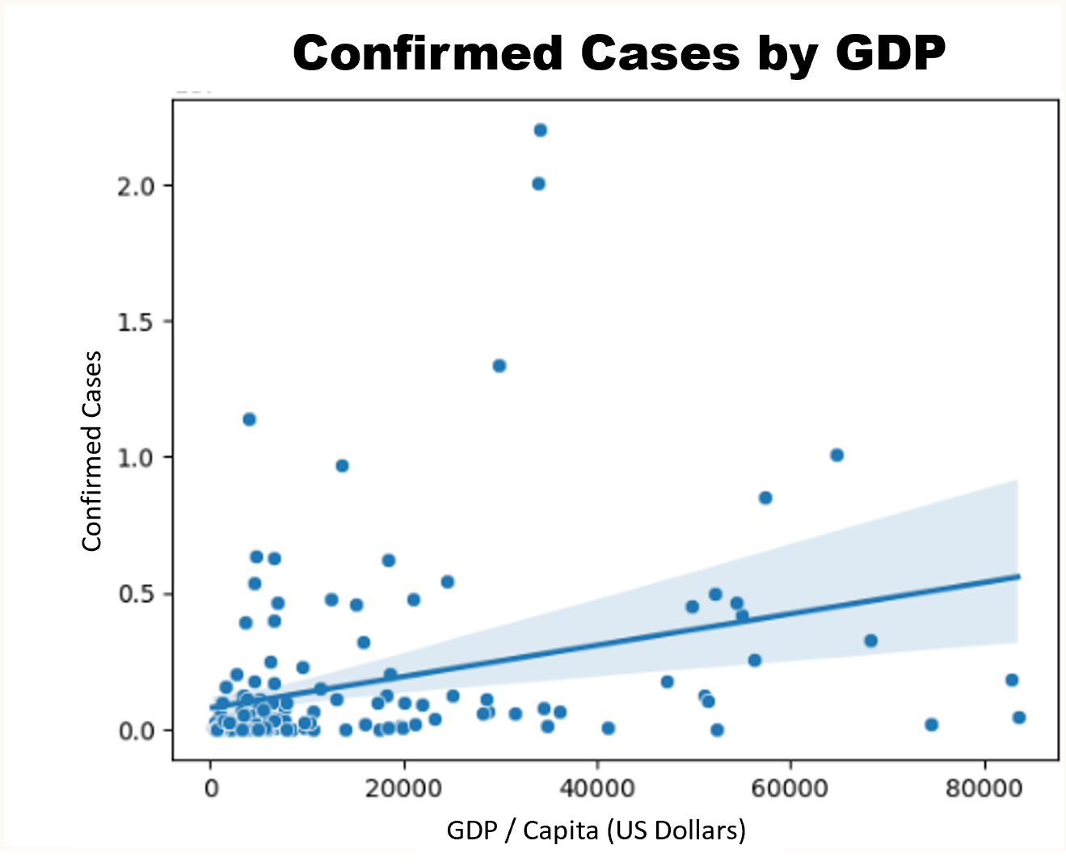
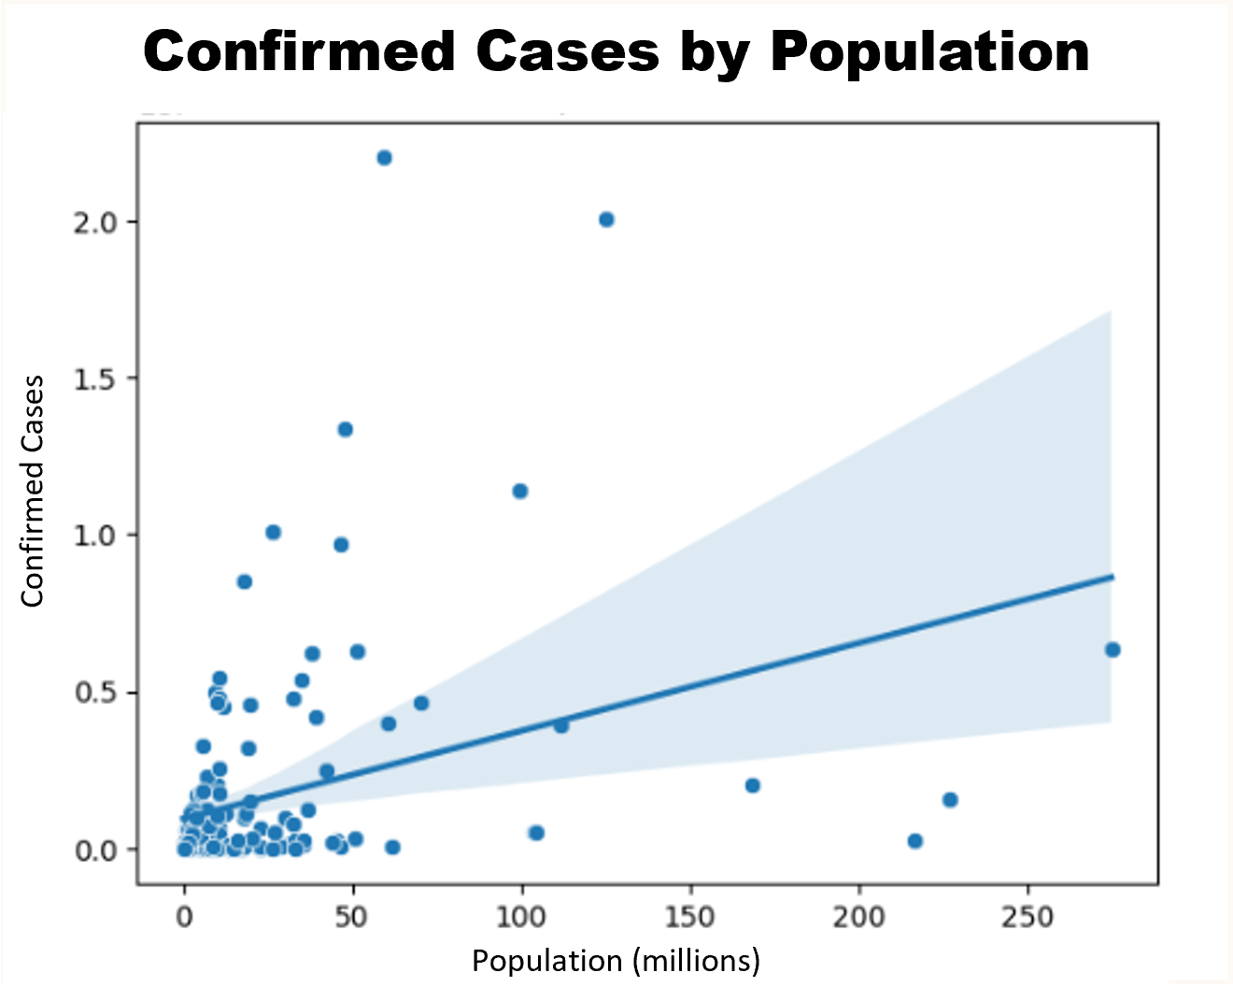
P>|t|: 4.84 e-5
COEF: 57.6124
COVID-19 GDP / POPULATION INSIGHTS
P>|t|: 9.61 e-6
COEF: 2.797 e+4

Slide 7
Questions?
References:
International Monetary Fund. (2023). Download WEO Data: October 2023 Edition. [Data set]. https://www.imf.org/en/Publications/WEO/weo-database/2023/October
John Hopkins Hospital (2023). Coronavirus Cases and Deaths. [Data set]. https://nuttaphat.com/covid19-api
M-Media-Group (2023). Covid-19-API [Data set]. https://github.com/M-Media-Group/Covid-19-API
Worldwide; IMF. (2023). The 20 countries with the lowest estimated gross domestic product (GDP) per capita in 2023. [Data set]. https://www.statista.com/statistics/256547/the-20-countries-with-the- lowest-gdp-per-capita/
Worldwide; IMF. (2023). The 20 countries with the largest gross domestic product (GDP) per capita in 2022. [Data set]. https://www.statista.com/statistics/270180/countries-with-the-largest-gross-domestic- product-gdp-per-capita/

